Slide 1
How Computers Compute
AMSC/CMSC 460 Spring 2022
Dr. Christopher Moakler

Slide 2
Needlessly Vague Questions
What are the main ways in which we engage in the Scientific Method?
Why do we use computation?
What is a computer?

Slide 3
NACA High Speed Flight Station "Computer Room"

Slide 5
https://sliderulemuseum.com/SR_Course.htm

Slide 6
Difference Engine
(Babbage 1820s)
https://commons.wikimedia.org/wiki/File:Babbage_Difference_Engine.jpg

Slide 7
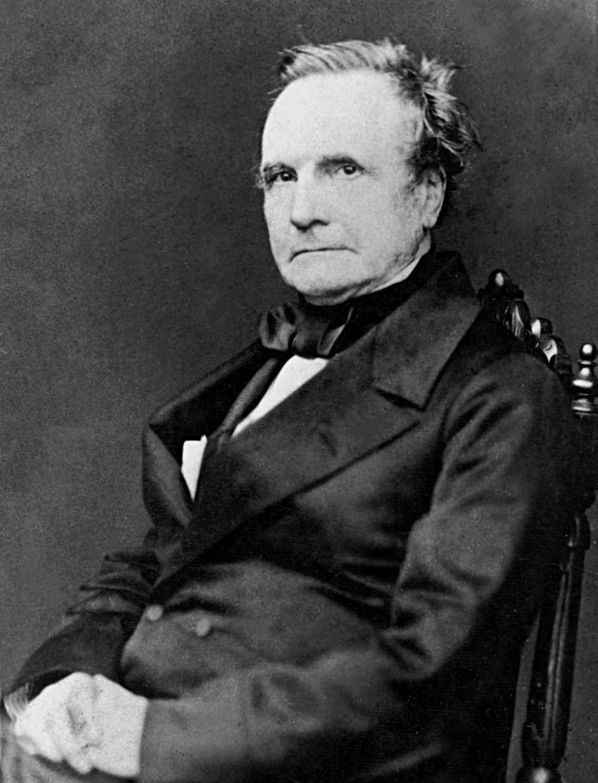
Analytic Engine
Charles Babbage proposed a successor to his Difference Engine, the Analytic Engine.
The Analytic Engine was designed to be a “general purpose computer”
He ran out of money and never built it.
It would have been the first Turing-complete computer.
https://commons.wikimedia.org/wiki/File:Charles_Babbage_-_1860.jpg

Slide 8
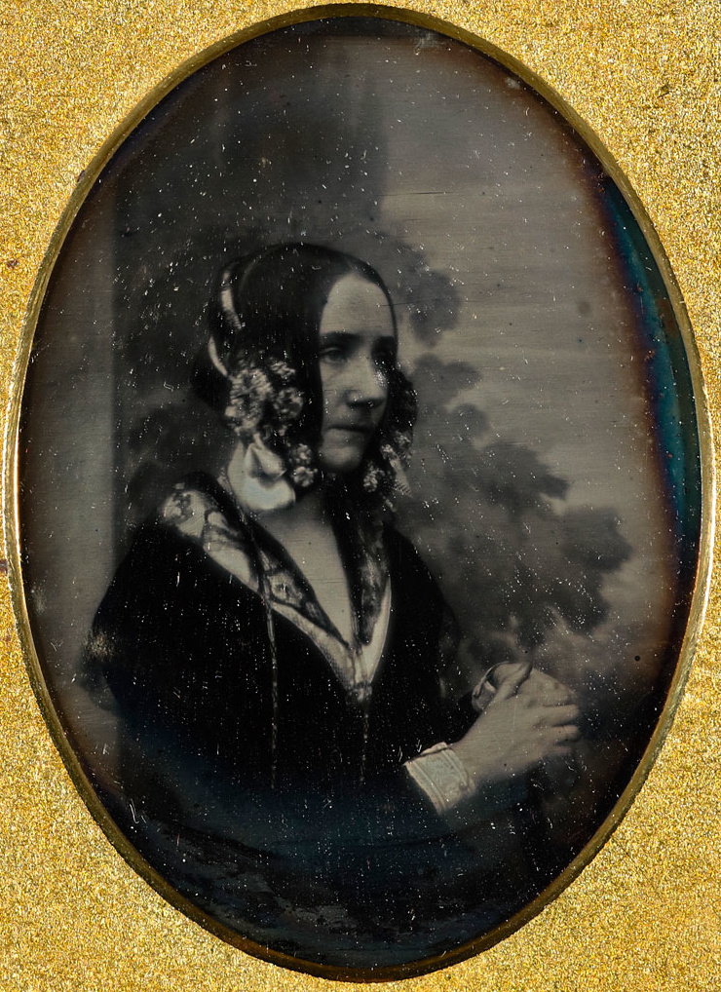
Ada Lovelace
The daughter of the poet Lord Byron.
Her mother, Lady Byron, was a mathematician.
Lord Byron left Lady Byron and died when Ada was only 8.
Her mother didn’t want Ada becoming a poet so she had her tutored in mathematics.
Many say Ada Lovelace wrote the first computer program for Babbage’s Analytic Engine
https://commons.wikimedia.org/wiki/File:Ada_Byron_daguerreotype_by_Antoine_Claudet_1843_or_1850.jpg

Slide 9
[The Analytical Engine] might act upon other things besides number, were objects found whose mutual fundamental relations could be expressed by those of the abstract science of operations, and which should be also susceptible of adaptations to the action of the operating notation and mechanism of the engine...Supposing, for instance, that the fundamental relations of pitched sounds in the science of harmony and of musical composition were susceptible of such expression and adaptations, the engine might compose elaborate and scientific pieces of music of any degree of complexity or extent.
-Ada Lovelace

Slide 10
What are the Pros and Cons of Computers?

Slide 11
What is a Number?

Slide 12
The Classes of Numbers
https://www.science4all.org/article/numbers-and-constructibility/

Slide 13
What is a Function?

Slide 14
Sauer

Slide 15
Floating Point Numbers
When mathematicians utilize Real numbers they typically assume those numbers have infinite precision.
I.e., 3, $\frac{22}{7}$, π
Computers do not have infinite memory in which to store numbers.
Computers almost universally store Floating Point numbers in the IEEE 754 standard.
This way of encoding numbers is incredibly well thought out and effective.
However, it creates some interesting situations for us as computational scientists.

Slide 16
IEEE 754 Single Precision Floats
https://en.wikipedia.org/wiki/Floating-point_arithmetic

Slide 17
Other Precisions
Why might these other formats be useful?
https://blogs.nvidia.com/blog/2019/11/15/whats-the-difference-between-single-double-multi-and-mixed-precision-computing/?ref=Welcome.AI

Slide 18
Problems with binary representation
How many 3-digit numbers exist between 9.00 and 9.99?
These numbers are represented in 10-digit binary as the numbers between 1001.000000 and 1001.111111.
How many binary numbers is this?
In this example, we want to represent 100 distinct numbers with only 64 possible representations.
We can not always reliably convert from decimal to binary and back again.
100
64

Slide 19
Rounding
In the IEEE 745 standard, if a double precision number has a 1 in the 52nd binary place, it is rounded up.
If the 52nd binary place contains a 0, we chop it which is rounding down.
If the digits after the 52nd binary place are 1000…, we round up or down depending on what makes the 52nd place 0.
Why?

Slide 20
Function Evaluation
What is the fastest way to evaluate a simple polynomial such as
$f\left(x\right)=5x^{4}+2x^{3}+ x^{2}+3x+9$
Lets make this more concrete with a value for $x$.
$f\left(\frac{1}{2}\right)=5{(\frac{1}{2})}^{4}+2{(\frac{1}{2})}^{3}+ {7(\frac{1}{2})}^{2}+3(\frac{1}{2})+9$
The most obvious way is also the most computationally expensive.
$f\left(\frac{1}{2}\right)=5(\frac{1}{2})(\frac{1}{2})(\frac{1}{2})(\frac{1}{2})+2(\frac{1}{2})(\frac{1}{2})(\frac{1}{2})+7(\frac{1}{2})(\frac{1}{2})+3(\frac{1}{2})+9$
This requires 10 multiplications and 4 additions.
What’s a better way and what makes it better?

Slide 21
Computational Considerations
Computers are very very fast at performing multiplication and addition.
As we’ve said however, they are also very very dumb.
If you tell a computer to perform the previous calculation, it will manually perform the division, $\frac{1}{2}$, ten times.
These types of computations can really add up.
The computer will not realize it is repeating calculations.
Depending on your language, the computer will evaluate $\frac{1}{2}$ to 0.
Computers are only as good as the person writing the code!

Slide 22
A better way to compute polynomials
As we mentioned, the computation of ${(\frac{1}{2})}^{4}$, required us to compute ${(\frac{1}{2})}^{3}$.
We can calculate the 4th order term first and store the partial multiplications as we go.
This requires 3 multiplications of $(\frac{1}{2})$, 4 additional multiplications, and finally 4 additions.
A reduction from 14 to 11 FLOPs

Slide 23
Horner’s Method
After a lot of thought, we can rewrite our polynomial as
$f\left(x\right)=9+x(3+x\left(7+x\left(2+x\left(5\right)\right)\right))$
This requires 4 multiplications and 4 additions
Now we have a reduction from 14 to 8 FLOPs!

Slide 24
Why does any of this matter?
In this course we will be using computers to find answers to mathematical, scientific, or engineering questions.
Those questions will often require extremely precise and accurate answers and we often want those answers quickly.
A round off error might make your program fail to converge entirely.
You might have to approach your problem in an entirely different way.
The way you write code might be inefficient and not converge in a reasonable amount of time.
If you’re a graduate student trying to graduate in 5 years, code that takes a month to run might extend your time stuck in school.

Slide 25
Why does any of this matter?
When using code to find answers to these sorts of problems, you really need to think about what you want.
Do you prefer precision and accuracy over speed?
Do you need an answer more quickly and it’s ok to have an approximate answer?
Do you need to answer similar problems frequently or do you just need the answer to one problem?
Do you want your code to be very readable because other people will be using it or do you want it to be incredibly fast and eschew readability?

